Slide 1
The fun and insightful tools possible with integrating Career Services Data
Kevin deike

Slide 2
Some of our biggest challenges
What can be done to improve student retention and graduation rates?
How can student engagement be expanded and measured?
How can academic departments and programs continue to evolve to not only keep up, but help lead the growth of career fields and our community?

Slide 3
The Current Scope
Background Info
Students: academic and other demographic background
Student Engagement, grades, SAP
Outcomes
Students: Retention, graduation
While at College

Slide 4
The New Approach (Holistic)
All departments
All participants
All data
Working together

Slide 5
The college-wide impacts of Career Services across the country
Career Readiness – National Association of Colleges and Employers (NACE)
Key competencies all businesses seek in college graduates that are also skills vital to retention, graduation, and academic success
Broaden Measurement and Application of Data – The Career Center @ University of Illinois
Needs, Participation, Satisfaction, Outcomes (First Destination, Academic Performance, Learning)
Use existing department efforts to broaden each other’s student engagement offerings – The Career Leadership Collective
Apply Machine Learning to measurements from initiatives that sprout from ideas like the above to establish how they contribute to the success of all involved and allow for continuous process improvement – Predicting Employment through Machine Learning (NACE Journal, May 2019 Cover Article)

Slide 6
The Scope of the New Approach
Initial Info
Students academic and other demographic background
Faculty academic programs and current faculty credentials
Staff student services and grant funded opportunities
Employers community and program engagement opportunities
Student Engagement
Outcomes
Students Retention, graduation, employment, continuing education
Faculty Grades, professional development, competitive curriculum
Staff student engagement, operational metrics, professional development
Participation Interaction Follow-up
Employer engagement, hiring, employee retention

Slide 7
The Simplicity of the New Approach
How this effort grows is based on what each department already does best.
Take a new level of measurement with current initiatives
Create efforts and combine results with other departments
What about our current task (like curriculum development) can benefit another (like faculty professional development)?
What about other tasks (like employee relations) can benefit a primary concern (like student engagement)?
How can such new approaches be easily and consistently measured?
Success will look different for every department and college.

Slide 8
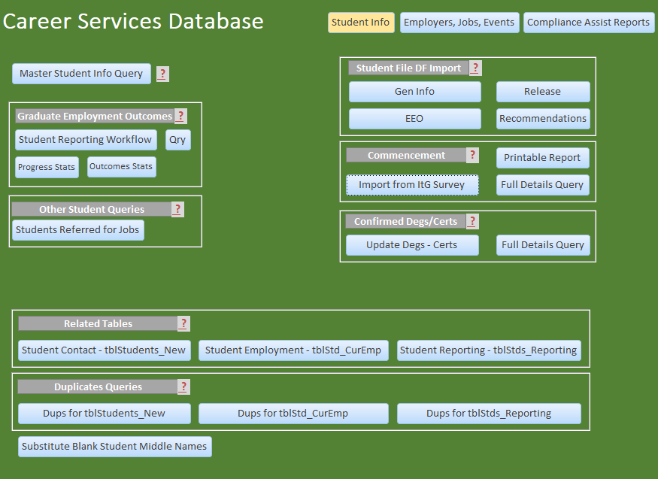
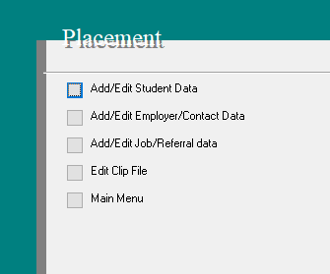
The Case of PSCC Career Services

Slide 9
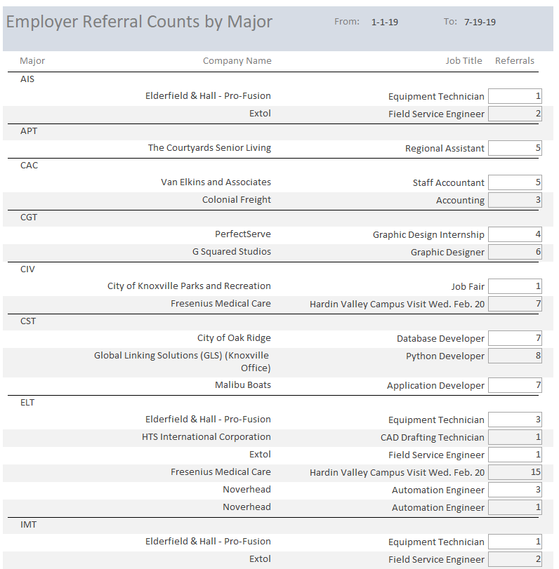
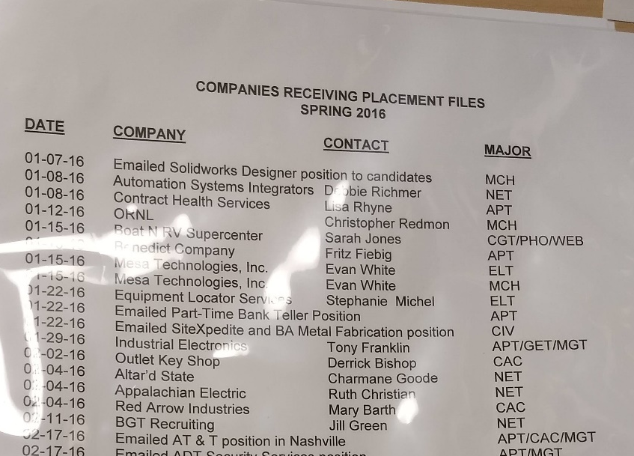
The Case of PSCC Career Services

Slide 10
Putting the New Approach to Test
New perspective on existing data – the Placement Employment Outcomes Report:
Interactive Major Outcomes Explorer (works best with Google Chrome) - https://app.powerbi.com/view?r=eyJrIjoiNmY2ZWViMWYtZjIzYS00ZTI4LTg3NzEtMTMwMzliMzFhNTEwIiwidCI6IjRlNGQyZWE5LTcyYTctNDQ0OC1iNDQwLTcyZGVmYTY5NjNiNiIsImMiOjN9
RIASEC Major Explorer - https://app.powerbi.com/view?r=eyJrIjoiNTdhOGI1OGEtZjNhYS00MjM2LWEzZDYtYjE0NDgwZTc4ZTI0IiwidCI6IjRlNGQyZWE5LTcyYTctNDQ0OC1iNDQwLTcyZGVmYTY5NjNiNiIsImMiOjN9

Slide 11
References
Berlin, Kenny. “3 Ways Big Data has Increased the Career Center Value to the Campus.” The Career Leadership Collective. May 21, 2017. https://www.careerleadershipcollective.com/single-post/2017/05/21/3-Ways-Big-Data-has-Increased-the-Career-Center-Value-to-the-Campus
“Career Readiness Defined.” National Association of Colleges and Employers. https://www.naceweb.org/career-readiness/competencies/career-readiness-defined/
Hugo, Linsey S. “Predicting Employment through Machine Learning.” National Association of Colleges and Employers. May 1, 2019. https://www.naceweb.org/career-development/trends-and-predictions/predicting-employment-through-machine-learning/
Makela, Julia Panke, et al. “Crowd-pleasing Data Management for Career Services: Easy, Accessible, Instant, Meaningful.” National Career Development Association 2016 Conference. https://www.careercenter.illinois.edu/sites/default/files/downloads/NCDA2016-CrowdPleasingDataManagement-FINAL.pdf

